Slide 1
Computing with CORGIS: Diverse, Real-world Datasets for Introductory Computing
Austin Cory Bart, Ryan Whitcomb, Dennis Kafura, Clifford A. Shaffer, Eli Tilevich
Virginia Tech

Slide 2
Overview
Bringing real-world data into introductory computing classes
Via a new system that manages and produces datasets
In order to motivate non-computing majors

Slide 3
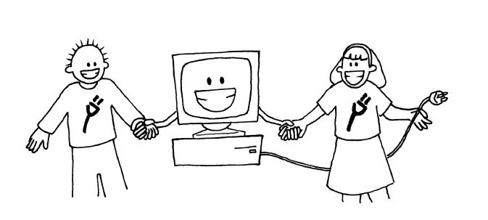



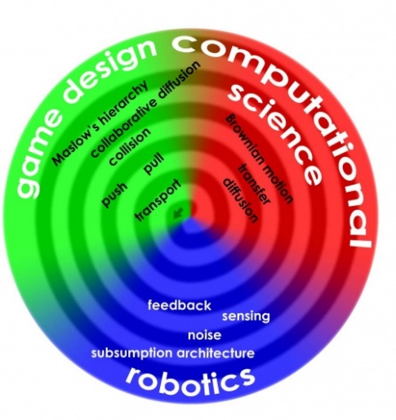

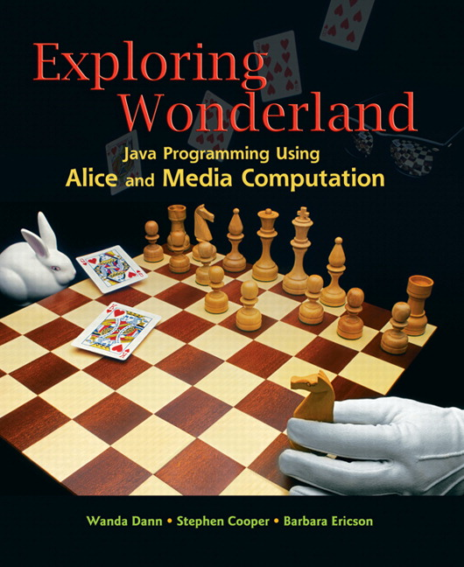
Computer Science For All

Slide 4
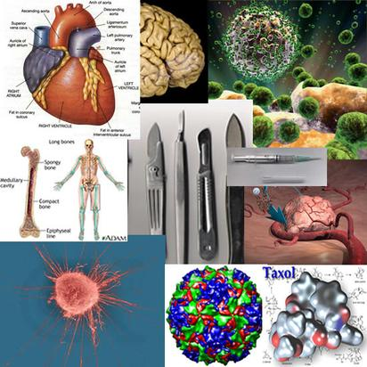

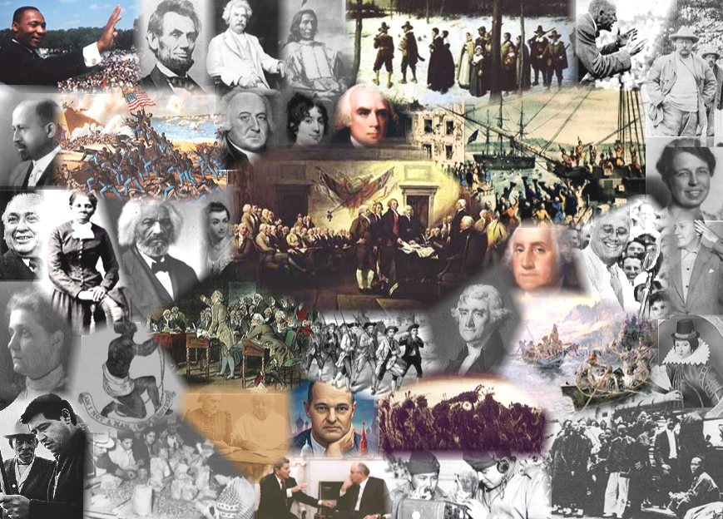
Diverse Majors
… with Rich Knowledge
English
Biological Sciences
Animal Sciences
Education
Chemistry
Theater Arts
History
Building Construction

Slide 5

(1) No Prior Background
“I’ve never done this before.”

Slide 6

(2) Low Self-efficacy
“I have no idea how to do this!”

Slide 7

(3) Unclear on Why
“Why am I doing this?”

Slide 8
MUSIC Model of Academic Motivation
Students are more motivated when they perceive that:
they are eMpowered,
the content is Useful to their goals,
they can be Successful,
they are Interested, and
they feel Cared for by others in the learning environment
B. D. Jones. Motivating students to engage in learning: The MUSIC model of academic motivation. International Journal of Teaching and Learning in Higher Education, 21(2):272–285, 2009.

Slide 9
Motivation → Engagement
Motivation
Engagement Outcomes
Persistence
Proactivity
Attendance
…
Learning
eMpowerment
Usefulness
Success
Interest
Caring

Slide 10
A spectrum
FOR-EACH
WHILE
Games
Websites
Recursion
Iteration
Development
Mobile Apps
IF
Algorithms
Images
Content
Context
Media Computation
Assignment
Audio
Data Structures
Scientific Modelling
Animations
Dictionaries
Scientific Computing
Lists
Arrays
Integers
Math
Booleans

Slide 11

Authenticity
Situated Learning
“Relevant”, “Real-world”
Media Computation as an “Imagineered Authentic Experience”
*Mark Guzdial and Allison Elliott Tew. 2006. Imagineering inauthentic legitimate peripheral participation: an instructional design approach for motivating computing education. In Proceedings of the second international workshop on Computing education research (ICER '06). New York, NY, USA, 51-58

Slide 12
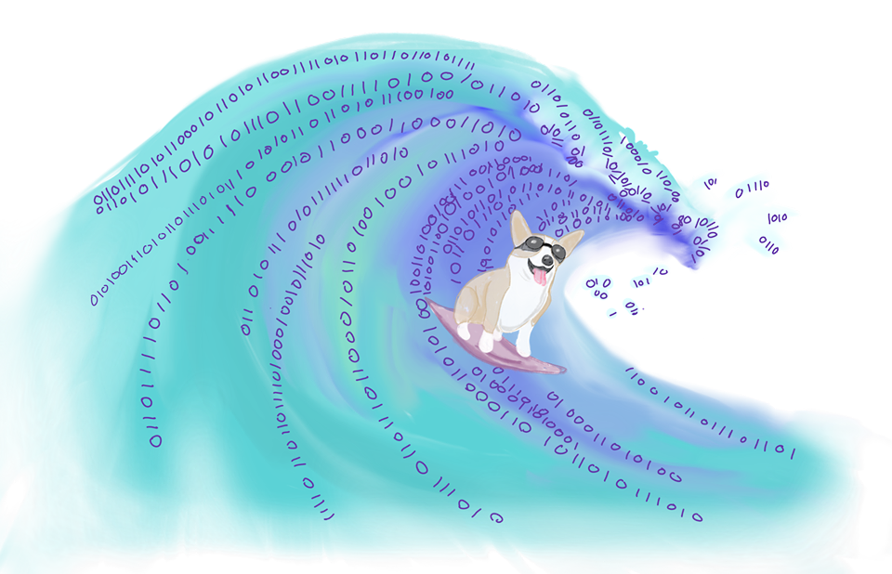
Why are we teaching computing?
“A Tidal Wave of Data”

Slide 13
State of the Art
Bart 2014 – Connecting to real-time APIs (RealTimeWeb)
Hamid 2016 – More generalized framework for real-time APIs (Sinbad)
Subramanian 2014 – Visualization of data structures with real data (BRIDGES)
Anderson 2014 – Real world data in CS1
Sullivan 2013 – Data Science for non-majors

Slide 14
Problem – We Need Data
ICPSR – Tightly controlled datasets
UCI Machine Learning – Only for machine learning
Census.gov, Kaggle, etc. – Not ready for beginners

Slide 15
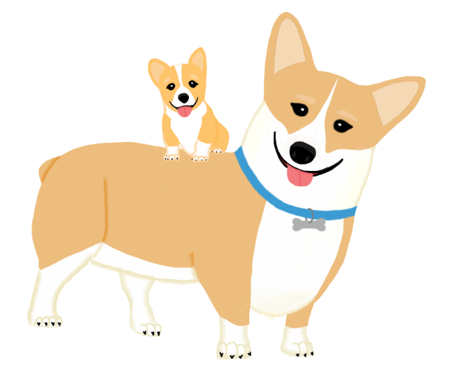
CORGIS
The Collection Of Really Great, Interesting, Situated Datasets

Slide 16
Metrics
42 datasets
267 mB
420,672 rows
9,365,520 values

Slide 17

Datasets

Slide 18

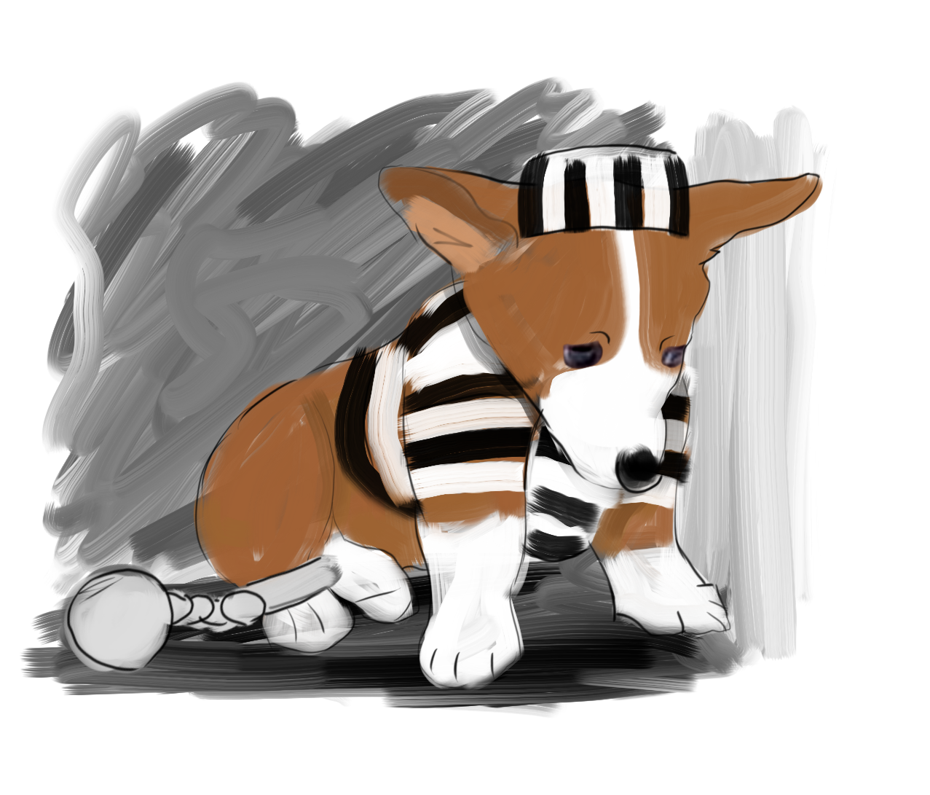


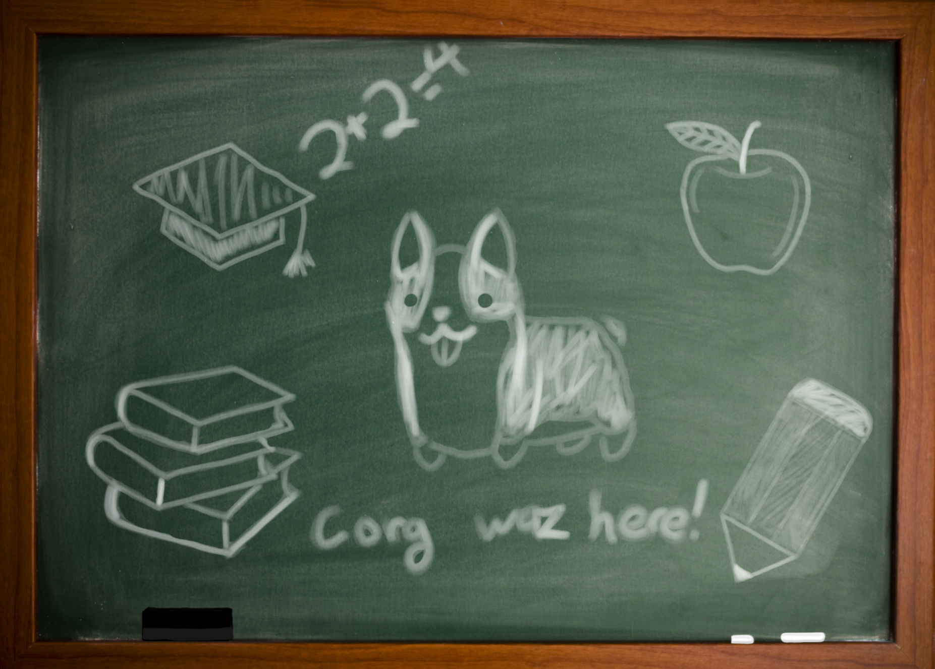



Connecting to Students’ Majors
English
Criminal Justice
Books
Crime
Geological Science
Weather
Aerospace
Education
Airlines
Theater Arts
Education
History
Building Construction
Theater
Immigration
Construction

Slide 19
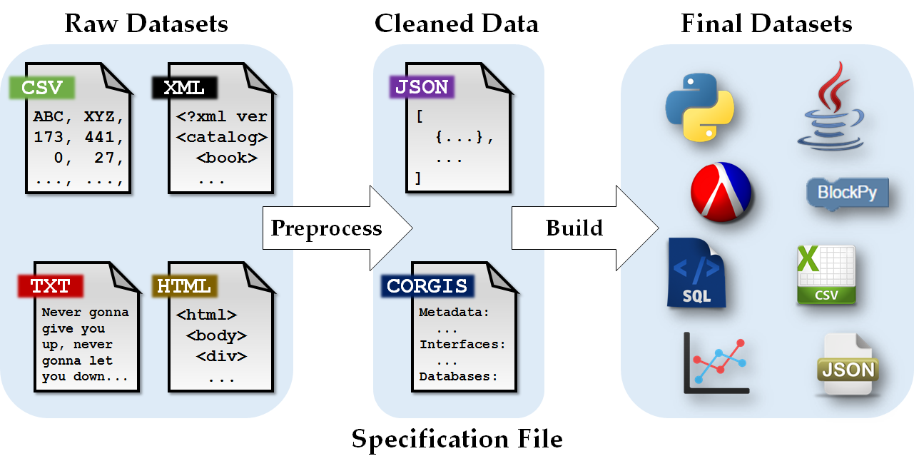
Architecture
Manual
Automatic

Slide 20
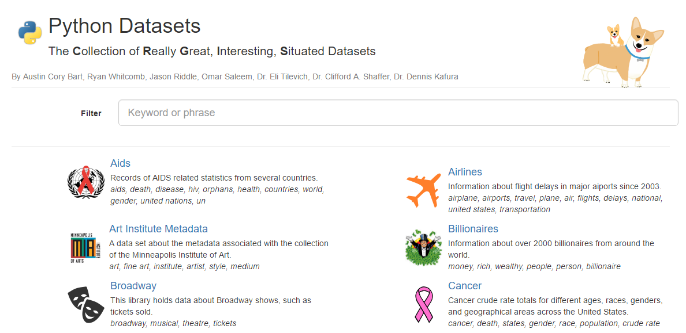
Gallery

Slide 21
Java, Python, Racket
// Java
import corgis.crime.StateCrimeLibrary;
import corgis.crime.domain.Report;
import java.util.ArrayList;
public class Main {
public static void main(String[] args) {
StateCrimeLibrary scl = new StateCrimeLibrary();
ArrayList<Report> reports = scl.getAll();
}
}
; Racket
(require crime)
(define reports (crime-get-all))
# Python
import crime
crime_reports = crime.get_all()

Slide 22
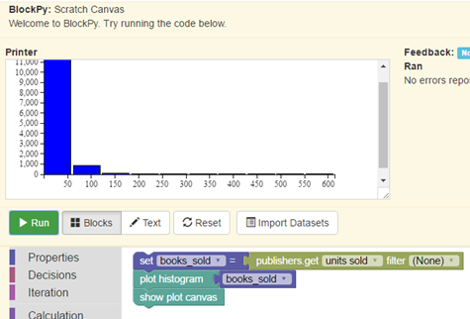
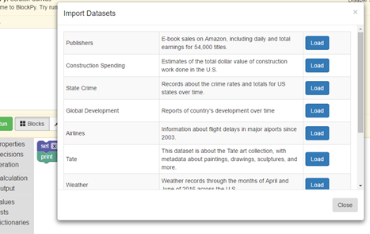
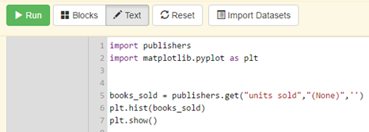
BlockPy

Slide 23
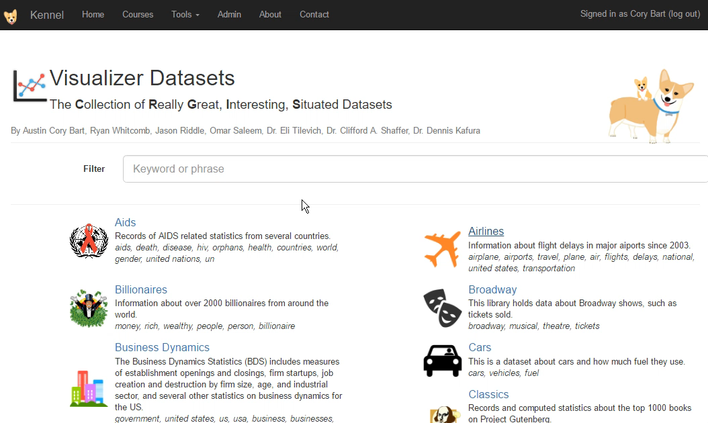
Visualizer Demo

Slide 24
Hypotheses
Context provides motivation
Students have some preference for Data Science
The usefulness of the context connects to engagement outcomes as strongly as the content

Slide 25
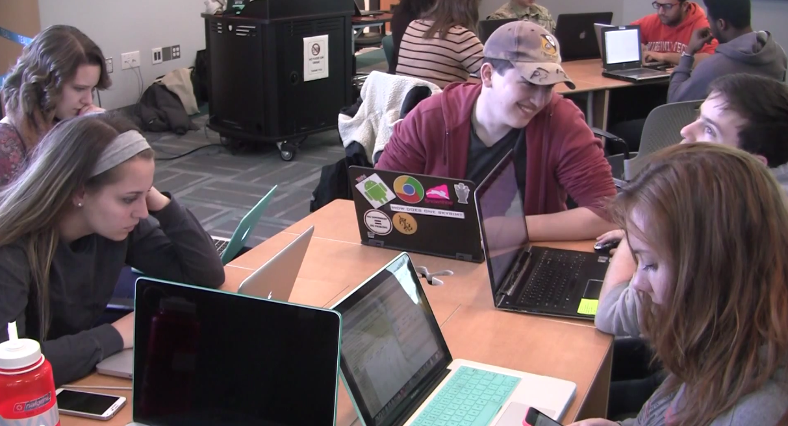
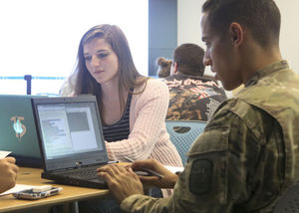
Interventions
Computational Thinking Course
Basic programming
Social Impacts
Data Science
6 semesters taught
Audience
Non-computing majors
Freshmen -> Senior
Gender balanced

Slide 26
Motivation × Course Components
Motivational Components
“I believe that I will have freedom to explore my own interests when I…” | eMpowerment
“I believe it will be useful to my long-term career goals to…” | Usefulness
“I believe I will be successful in this course when I…” | Success
“I believe it will be interesting to…” | Interest
“I believe that my instuctors and peers will care about me when I…” | Caring
Course Component
"... learn to write computer programs" | Programming Content
"... learn to work with abstraction" | Abstraction Content
"... learn about the social impacts of computing" | Social Ethics Content
"... work with real-world data related to my major" | Data Science Context
"... work with my cohort" | Collaboration Facilitation
Likert
Strongly Disagree
Disagree
Somewhat Disagree
Neither Agree nor Disagree
Somewhat Agree
Agree
Strongly Agree

Slide 27
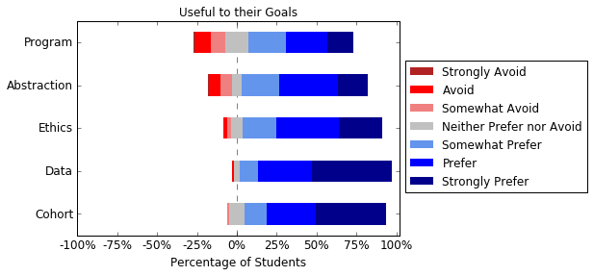
Context is Useful
N = 85, 62% Female
Students’ sense of the usefulness of various course components was highest for the context, lowest for the content.

Slide 28
Preference for Contexts
Likert
Strongly Avoid
Avoid
Somewhat Avoid
Neither Prefer nor Avoid
Somewhat Prefer
Prefer
Strongly Prefer
Preference for Contexts
“Working with data sets related to your major” | Data
“Working with pictures, sounds, movies” | Media
“Making games and animations” | Games
“Making websites” | Web
“Making scientific models of real-world phenomenon” | Scientific
“Controlling robots or drones” | Robots
“Making phone apps” | Mobile

Slide 29
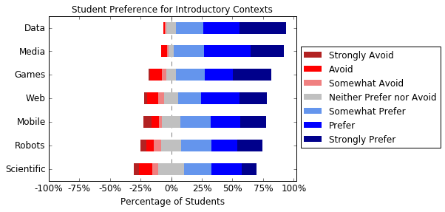
Preference for Contexts
N = 85, 62% Female
Students’ preferred a Data Science context over all others
* No significant difference with Media Computation according to KW test

Slide 30
Engagement (Intent to Continue)
Likert
Strongly Disagree
Disagree
Somewhat Disagree
Neither Agree nor Disagree
Somewhat Agree
Agree
Strongly Agree
Intent to Continue
“I will try to learn more about computing, either through a course or on my own.” | Learn
“I will recommend this class to others.” | Recommend
“I will directly apply what I have learned in my career.” | Apply

Slide 31
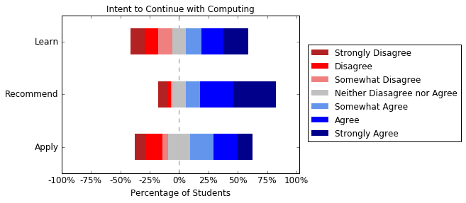
Engagement (Intent to Continue)
N = 85, 62% Female
Although students would recommend the course, many did not intend to continue learning more computing or applying what they learned.

Slide 32
Engagement vs. Components
Pearson correlation of “Student’s intent to continue learning computing” with
students’ perception of each course and motivational component
Fall 2016 | eMpowerment | Usefulness | Success | Interest | Caring
Abstraction
Cohort
Data
Ethics
Programming |  | .406 | .354 | .341
Not
significantly Correlated!
Significant
N = 85, 62% Female
Intent to continue seems to be correlated with the content, not the context.

Slide 33
Take-aways
Data Science seems to be a preferable context for students, across genders.
Context, and in particular Data Science, can seem to provide motivation in ways that content cannot
But some engagement outcomes might be more connected to content than context

Slide 34
Future Work
More Datasets
Maintenance
Connecting motivation to learning outcomes

Slide 35

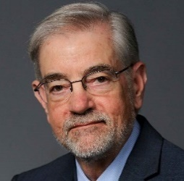


Thanks!
Clifford A. Shaffer
Dennis Kafura
Eli Tilevich
Ryan Whitcomb
We gratefully acknowledge the support of Virginia Tech and the National Science Foundation under Grants NSF DGE 0822220, NSF IUSE 1624320, and NSF IUSE 479632.

Slide 36
Questions?
https://think.cs.vt.edu/corgis
Artwork by Eleonor Bart

Slide 37
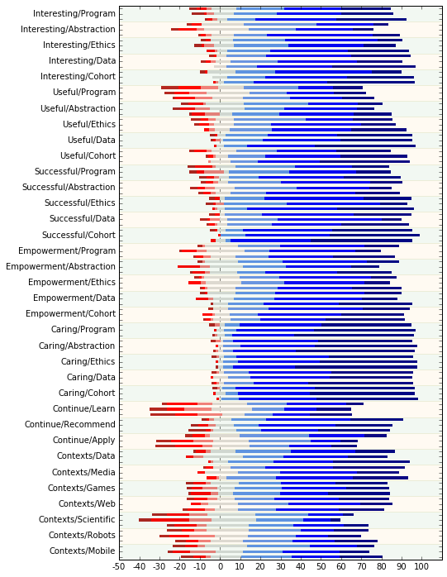
Trends in Motivation

Slide 38
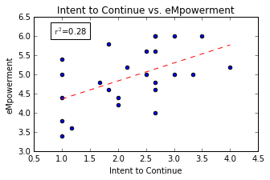
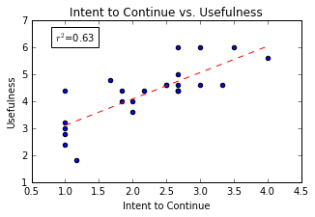
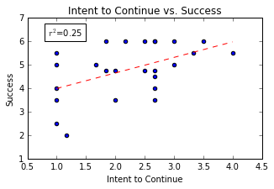
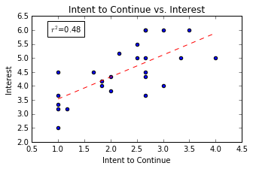
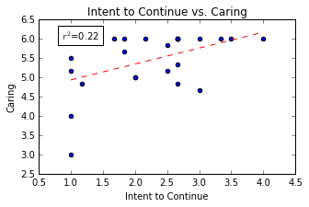

Slide 39
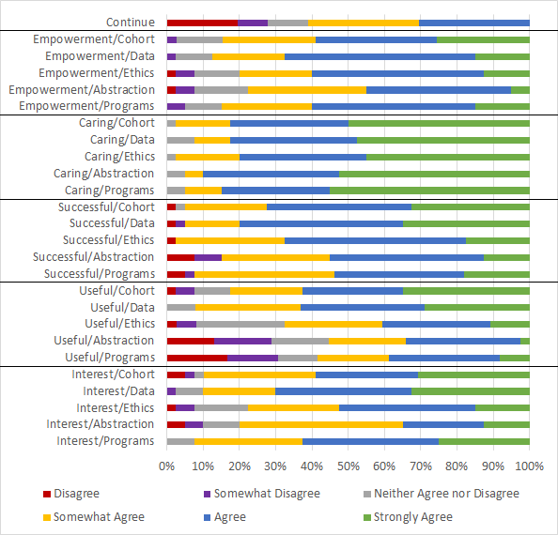

Slide 40
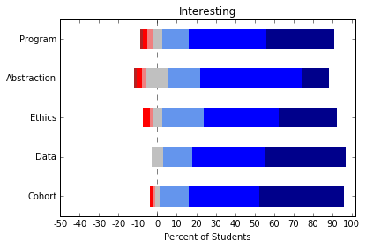
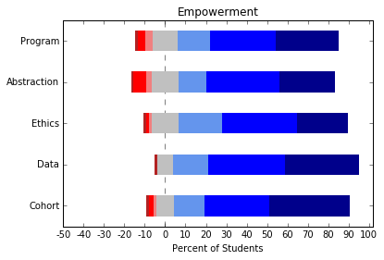
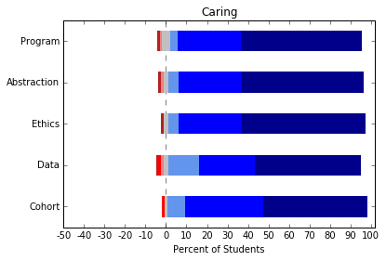
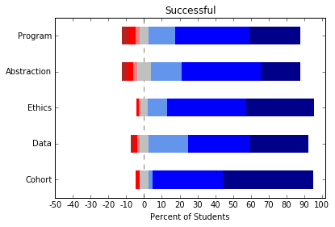
Other Components

Slide 41
Spring 2016 | eMpowerment | Usefulness | Success | Interest | Caring
Abstraction | .458 | .699 | .614 | .488
Cohort
Data
Ethics |  | .485 | .418 | .323
Programming | .437 | .823 | .600 | .638
Continue Learning, Applying, and/or Recommend Course
N =36
50% female

Slide 42
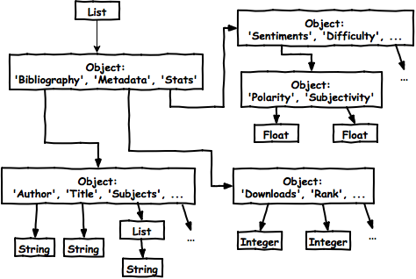
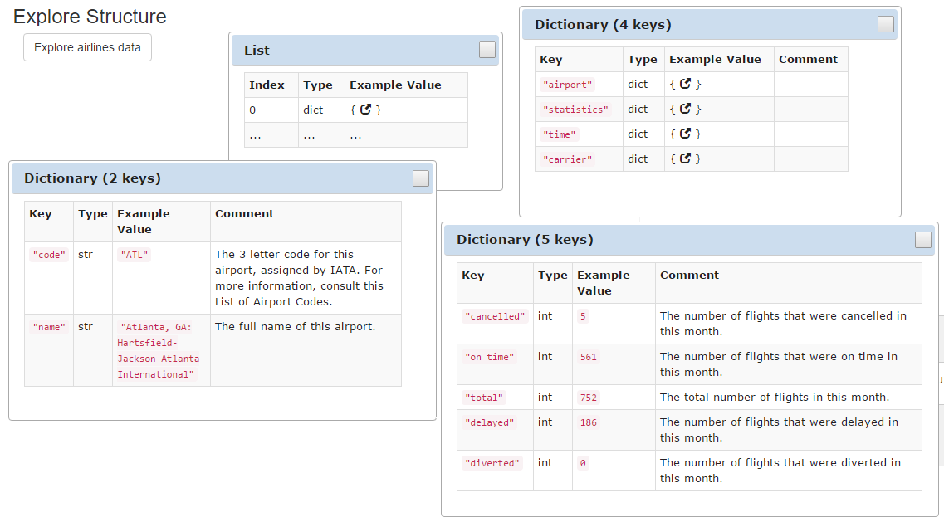
Structure

